Slide 1


PANIMALAR ENGINEERING COLLEGE
Department of Computer Science and Engineering
Department of Computer Science and Engineering
STUDENT CAREER+ APP
THIRD PROJECT REVIEW
CLOUD BASED
BATCH F1
T.SANTHOSH - 211417104243
K.SURESH KANNAN - 211417104276
P.PRADEEP - 211417104190
GUIDE : DR.S.MURUGAVALLI
HEAD OF DEPARTMENT - CSE

Slide 2
Introduction
Technology has become a part of our lives as it plays a vital role in enhancing our workflow. From setting reminders to connecting with people from different places, technology could also be used for betterment of a student’s career. Every student today owns their personal smartphone. In order to improve the communication between students and staff, a mobile application could act as a median. By implementing cloud functionalities over a mobile application, both students and staff could communicate professionally anywhere anytime. For students with backlogs, this application could help them manage their time by receiving messages everyday from the staff who taught him the subject. There are more functionalities added, that would benefit the overall career of a student.

Slide 3
Literature Survey
A survey on android based instant notification system | Android based Student Reminder System | The use and effect of smartphones in students’ learning activities | Impact of Mobile Learning on Students’ Achievement Results
Enotice Application it is fluke for students and staff all are can access this application through via mobile phone ,there is no need to go and visit physically anywhere to visit the notice board with the help of this application students and staff will get all notifications regarding studies, institute and also they will get all updates about college department and Corporate.It is helpful for all updates and notification, it is simply way to convey message for students and staff. It is the best facility for everyone because at one click students and staff can get all notice, updates and Information. This system applied in educational institutes as an online path of notice board and sharing system that can access and use anytime anywhere that means all in your hand. It is about a virtual system where everyone can use this application anywhere, simply we can check mails and it is an easy way to access and fill any application form regarding college and studies. | This application is mainly useful for the students in managing some of their daily college activities. Library reminder system is one of the features of this application. In this application the student enters the book details such as name of the book and date of the book issued. This application calculates the speciﬁed renewal date and on that date it reminds the students to renew the book. The ﬂow of this feature is shown as in ﬁg. 1. The details get stored in the database so that the student can view the details of the book he has taken from the library. The details stored in the database are the name of the book, date of the book issued and the number of days after the book needs to be renewed etc | It is blatant that the proliferation of the Internet and Information Communication Technology has affected almost every facet of teaching and learning, especially in distance education where course 30 is being delivered either by blended mode of teaching or fully online. With reference to the findings of this study, it was revealed that the distance learning students of the University of Ghana find it easy to use a smartphone in their academic activities which enhance their perceived usefulness of using a smartphone for learning activities. The findings can be attributed to the fact that since part of their course is delivery via digital mode, there is the tendency that they were fueled to learn how to use a smartphone to access the Sakai which is a common platform for course delivery. Also, the study found a positive usefulness of the use of smartphone in the students' learning activities such as easy sharing and accessing of lecture materials online, easy communication with colleagues and course masters, being able to carry smartphone any anywhere and at any time because of its portability as compared to a laptop and many others. | The results of this article reveal that the final achievement tests (as described in the article) proved that most of the students who had not used the described app for practicing after regular classes had done badly although they had an opportunity to study these words and phrases discussed and written down in the face-to-face classes on their own after the classes. However, they were not sent the notifications to remind them to study them, and thus they had fewer opportunities of exposure to the target language. The learning materials and tools, such as the described mobile app, designed based on students’ needs and continuously facilitated by a teacher, are effective in the enhancement of students’ performance and contribute to positive learning outcomes. In addition, the results also confirm that mobile learning can serve as an appropriate complementary method to other forms of course delivery thanks to its opportunities of frequent exposure to the target language. However, students were also encouraged to use the mobile app for the meaningful content and immediate feedback they received.

Slide 4
Problem Statement
In our project, we have developed an application that would be handy, easy to use and stable in performing operations over cloud. By integrating Firebase services as backend, there is no need of managing backend for this app as it is taken care completely and analysed well by the firebase module. A student or staff can receive notifications anywhere and anytime as the cloud functions are deployed in Google cloud platform. As a single notification on any aspect is possibly able to manage our tasks, a notification from staff on managing the study progress of a student is what we are implementing by developing this mobile application.
This application has been developed with more features added such as notes management, progress tracking and managing OD approval for a student attending events. Since firebase storage is encapsulated with several security models, data piracy and other security attacks are taken care of by firebase itself.
‹#›

Slide 5
Development Environment
Hardware :
Laptop or PC
System Configuration - intel core i7 With 16GB of RAM and Nvidia GTX1660Ti of 6GB
Smartphone - Running Android OS.
Software :
Android Studio , Visual Studio Code, Flutter SDK
Dart SDK, Android SDK, Firebase Integration toolkit
‹#›

Slide 6
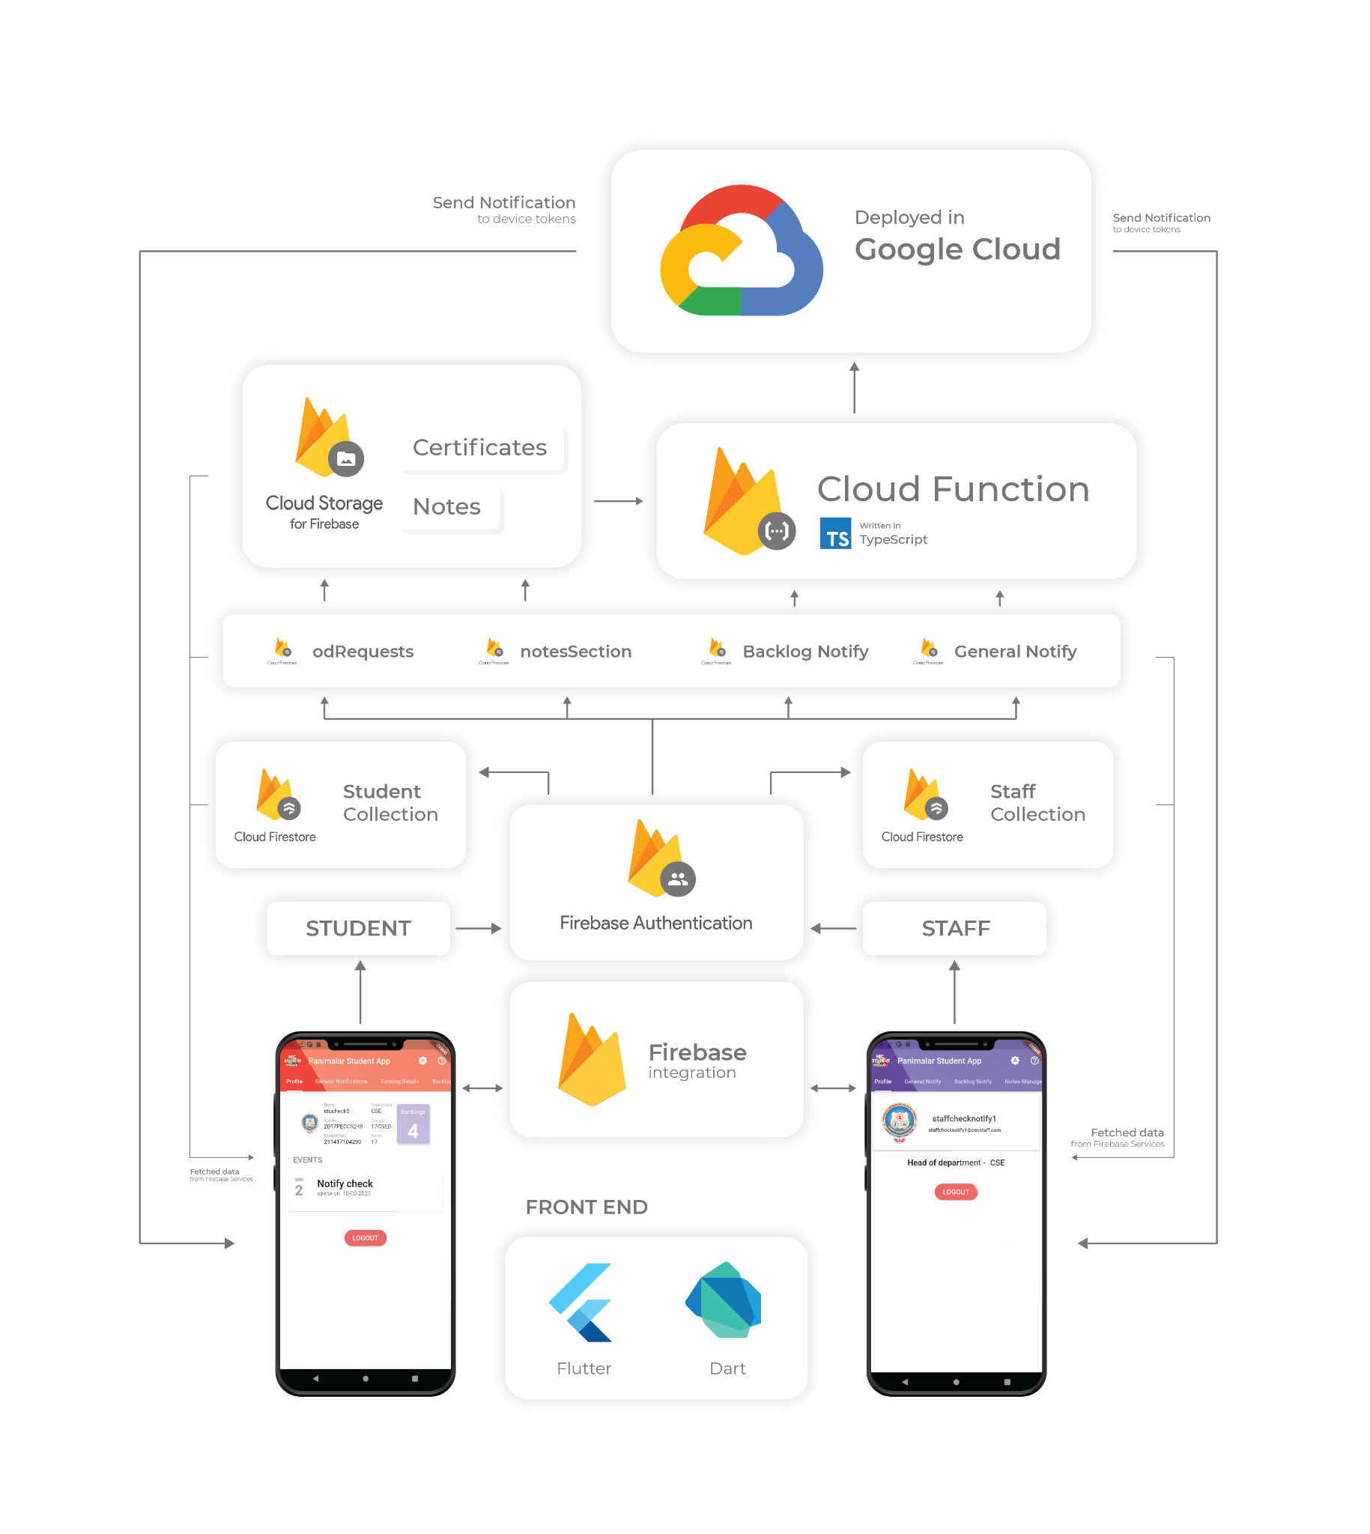
System Architecture
Interaction with Firebase Cloud Services
Front end : Flutter and Dart
Back end : Firebase Cloud services

Slide 7
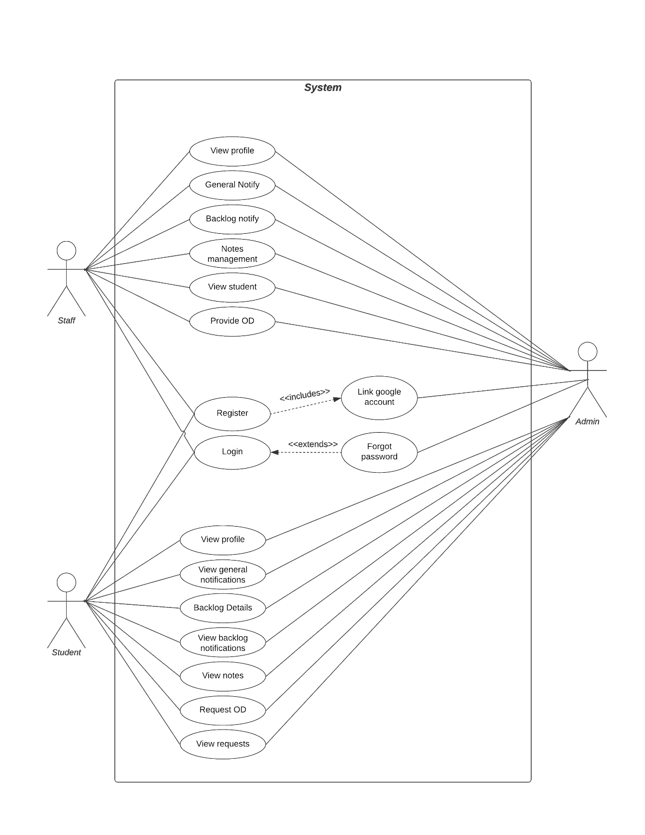
System Design
USE CASE DIAGRAM
ACTORS:
1. STAFF
2. STUDENT
3. ADMIN
STAFF USE CASES:
1. VIEW PROFILE
2. GENERAL NOTIFY
3. BACKLOG NOTIFY
4. NOTES MANAGEMENT
5. VIEW STUDENT
6. PROVIDE OD
COMMON USE CASES:
1. REGISTER
2. LOGIN
STUDENT USE CASES:
1. VIEW PROFILE
2. VIEW GENERAL NOTIFY
3. BACKLOG DETAILS
4. VIEW BACKLOG NOTIFY
5. VIEW NOTES
6. REQUEST OD
7. VIEW REQUESTS

Slide 8
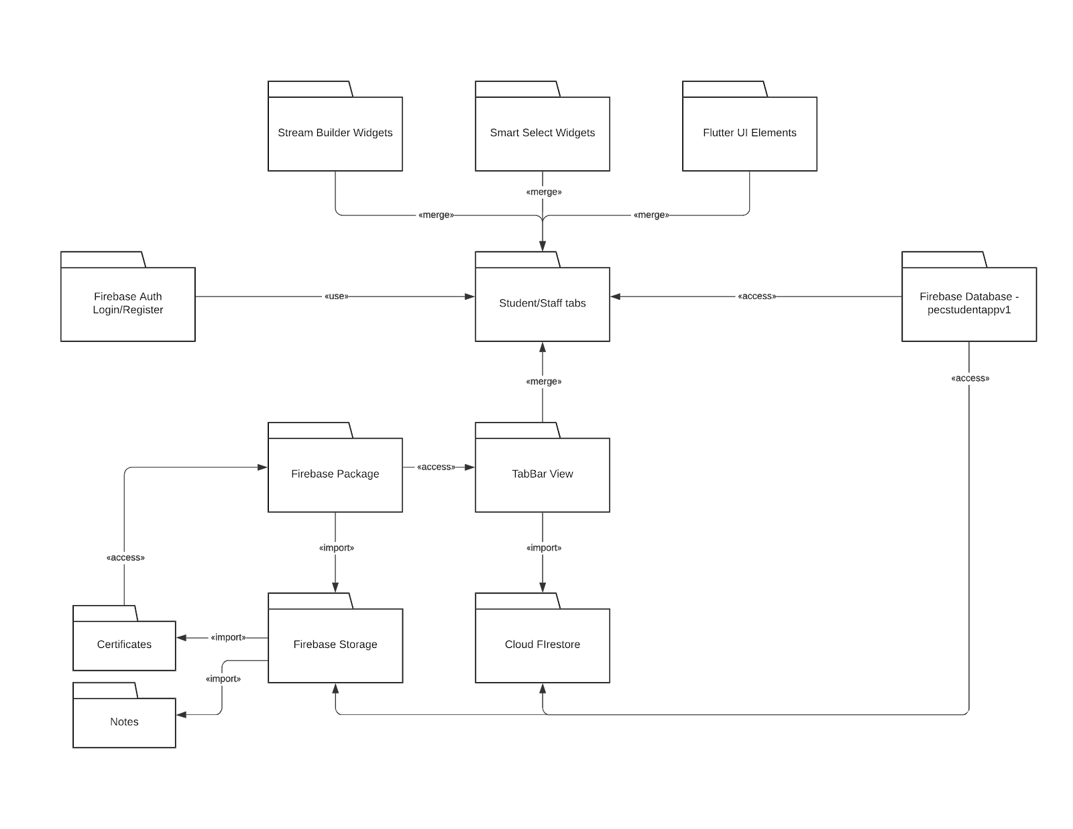
Package Diagram
Flutter packages and their interaction with both front end and back end

Slide 9
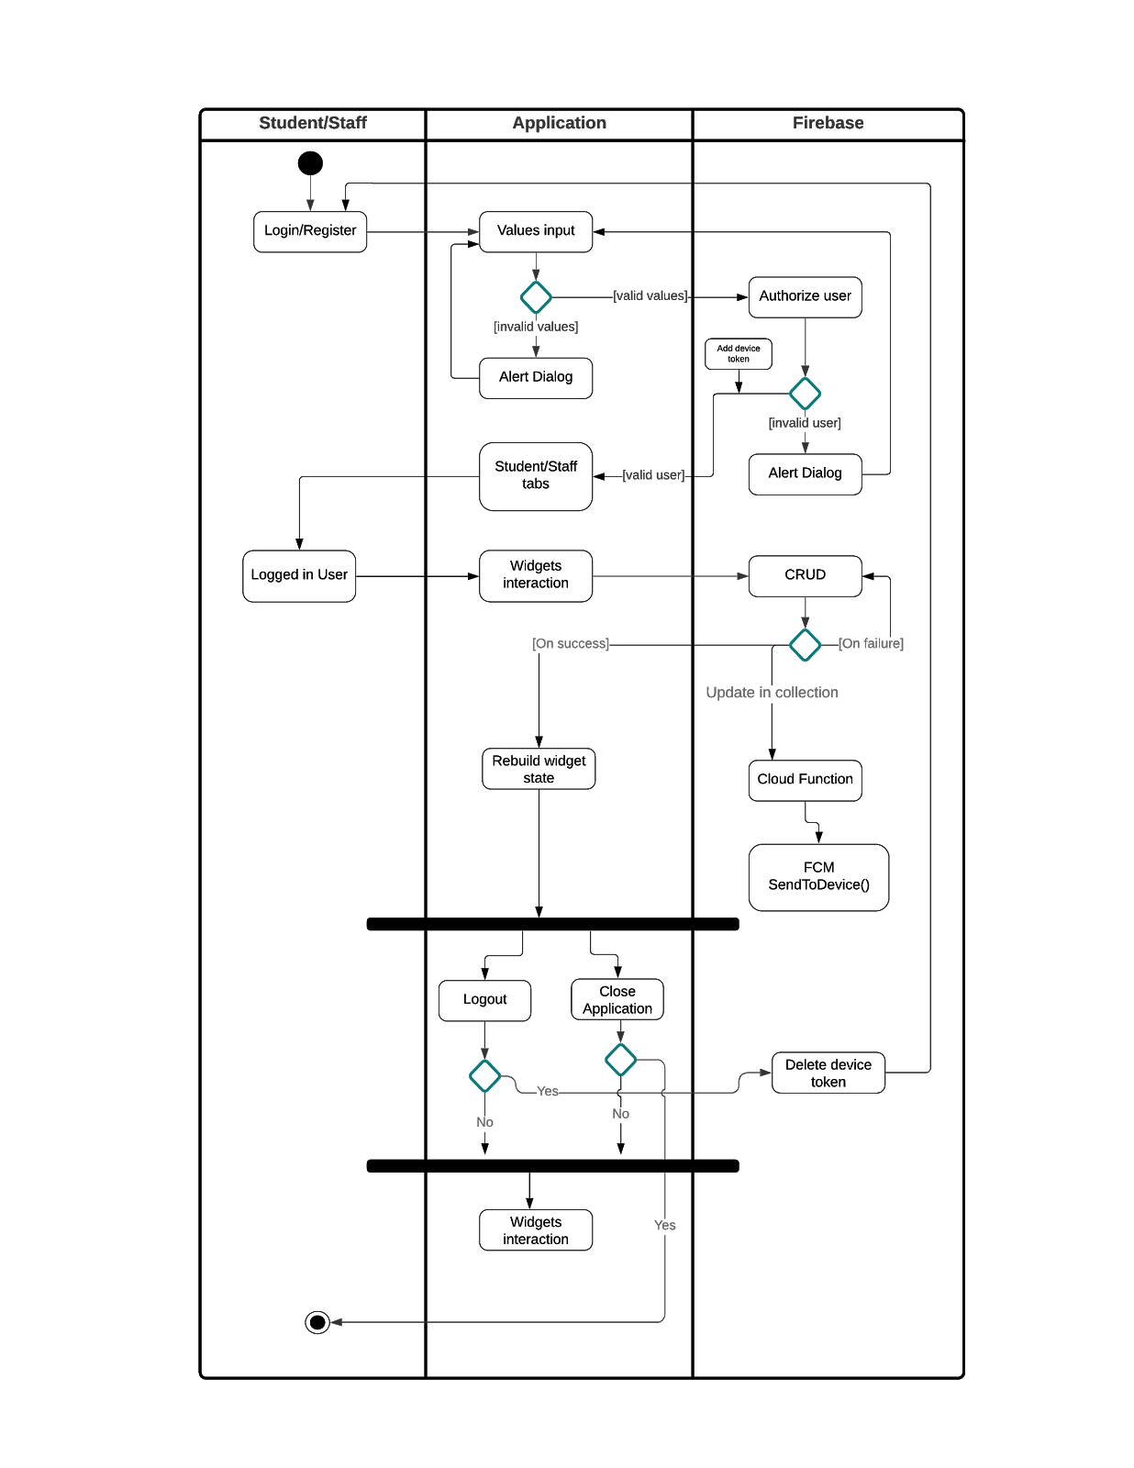
Flow Diagram
Interacting Within Application and Firebase Cloud Services

Slide 10
Modules and Functionalities
1. INTEGRATING FIREBASE WITH THE APPLICATION
2. STRUCTURING FIREBASE FIRESTORE
3. GETTING PACKAGE DEPENDENCIES
4. DEPLOYING CLOUD FUNCTIONS
5. COMMON FUNCTIONALITY USED
6. FIREBASE CRUD
7. FETCH DATA FROM FIRESTORE
8. STORING DATA IN FIREBASE STORAGE
9. FETCHING AND VIEWING DATA FROM FIREBASE STORAGE
10. BUILDING STREAM OF CARDS

Slide 11
Modules And Functionalities
1. INTEGRATING FIREBASE WITH THE APPLICATION
On creating a new firebase project in the firebase console , we download the services.json file which matches with the app id. On running “pub get” inside our application development environment terminal, we connect the application with firebase services.
2. STRUCTURING FIREBASE FIRESTORE
Inside our firebase project we created collections which stores data in different types and allows us to perform CRUD operations over cloud.

Slide 12
3. GETTING PACKAGE DEPENDENCIES
Lots of flutter developers have contribute to the community a bunch of flutter packages that can be used by developers to implement certain functionalities efficiently. Those flutter packages are imported to the application by implementing the dependency version of package under “pubspec.yaml” file, which then imports the package on running “pub get”.
Eg., dependencies:
flutter:
sdk: flutter
firebase_core: ^0.7.0

Slide 13
4. DEPLOYING CLOUD FUNCTIONS
Firebase offers “Firebase cloud function services” - on upgrading the free plan to ‘Blaze plan’ which costs the developer based on data read and writes that happen in the cloud.
We wrote three cloud functions so as to send notifications to devices which has their user logged in via the application.
Based on user needs the notification is send to device using the device tokens that are fetched from the firestore.
The function is written in typescript - which is highly recommended for working with firestore database.
We log in to firebase using cmd prompt and we use deploy functions to deploy the typescript file over Google Cloud platform.

Slide 14
CLOUD FUNCTIONS OF OUR APP
There are three functions in order to send notifications to different set of users.
From staff to students - General notifications based on classID.
From staff to students - Notifications sent based on backlogs.
From students to staff - Notifications sent on requesting OD.

Slide 15
5. COMMON FUNCTIONALITY USED
Firebase Cloud Messaging services is the major key for sending notifications. All three functions uses a common functionality but gets executed based on different conditions.
It refers to a collection/document and looks for any changes that happens inside the reference.
Create a list of string which would store the device tokens.
The device tokens are fetched from respective documents of users, and if the condition matches, the tokens inside the respective document is added to the list.
fcm.sendToDevice() method is used to send notifications to respective list of tokens along with the message to be displayed.

Slide 16
6. FIREBASE CRUD
In firebase it is easier to create, update or delete data. By using Flutter, it makes the process very much compatible.
We get inputs from the user using Flutter Widgets and store them inside a variable.
We refer to a collection or a document inside firestore integrated with the application. By using set method we store data.
_store.collection('staffs')
.doc(staffid).set({
'Name': name,
'department': department,
'email': email,
'designation': designation,
});
Similarly:
1.update() - Used to update data
2.delete() - Used to delete data
3.add() - Used to add field/data
Note : Methods vary on reference of collection/document

Slide 17
7. FETCH DATA FROM FIRESTORE
In order to fetch data from firestore we can either refer to a single document from a collection or we can fetch a snapshot of data from the reference collection. A snapshot is a stream of data that is in json format. We can refer to any field or check conditions on any value of a field based on our interests.
Eg., stream: _store.collection('odRequests').snapshots(),
builder: (context, snapshot)
The stream consists of Query snapshots which can be iterated and can be stored to a local variable.

Slide 18
8. STORING DATA IN FIREBASE STORAGE
By using flutter packages such as file_picker and image_picker we were able to ask user for permissions and allow user to select a local pdf file or a image based on their needs.
In order to store them in firebase storage we need to import firebase storage package and create a reference to our firebase storage module. Then use putFIle to add the file to the storage. Eg.,
StringfilePath= 'notes/${Department}/${_subjectcode[0]}/${_classid.toString()}/${getChosenPdfName}';
FirebaseStorage storageReference = FirebaseStorage.instance;
Reference ref = storageReference.ref().child(filePath);
UploadTask uploadTask = ref.putFile(getChosenPDF);

Slide 19
9. FETCHING AND VIEWING DATA FROM FIREBASE STORAGE
In order to view the respective uploaded file, we first add the reference url of the file in firestore. Then we fetch them using _store.get() method and we will be able to review them. In order to delete the file we use the same reference url and the file path. The file path is mandatory in order to delete the file from firebase storage.
Eg.,
await uploadTask.whenComplete(() {
ref.getDownloadURL().then((fileURL) {
setState((){
//add the file path and refernece url inside a collection
});
});

Slide 20
10. BUILDING STREAM OF CARDS
In the application, the process of building widgets based on the condition inside a stream of snapshots occurs most often.
We use flutter’s stateless widgets which are capable of rebuilding themselves based on a condition.
The stream of snapshots are iterated through for loop and if a specific condition matches we store the snapshot data to a local variable and build a card passing the local variable to them.
final uploadedPDF = snapshot.data.docs;
List<pdfViewCard> pdfCards = [];
//iterate through uploadedPDF and store values in local variable

Slide 21
Testing /Performance Evaluation
Test Case 1 : Student Login Page
Test Case 2 : Staff Login Page
Test Case 3 : Register Page
Test Case 4 : General Notification Sent Module
Test Case 5 : Backlog Notification Sent Module
Test Case 6 : Notification received module
Test Case 7 : Upload module
Test Case 8 : OD Module
Test Case 9 : Reset google linked account
Test Case 10 : Login and Logout Module

Slide 22
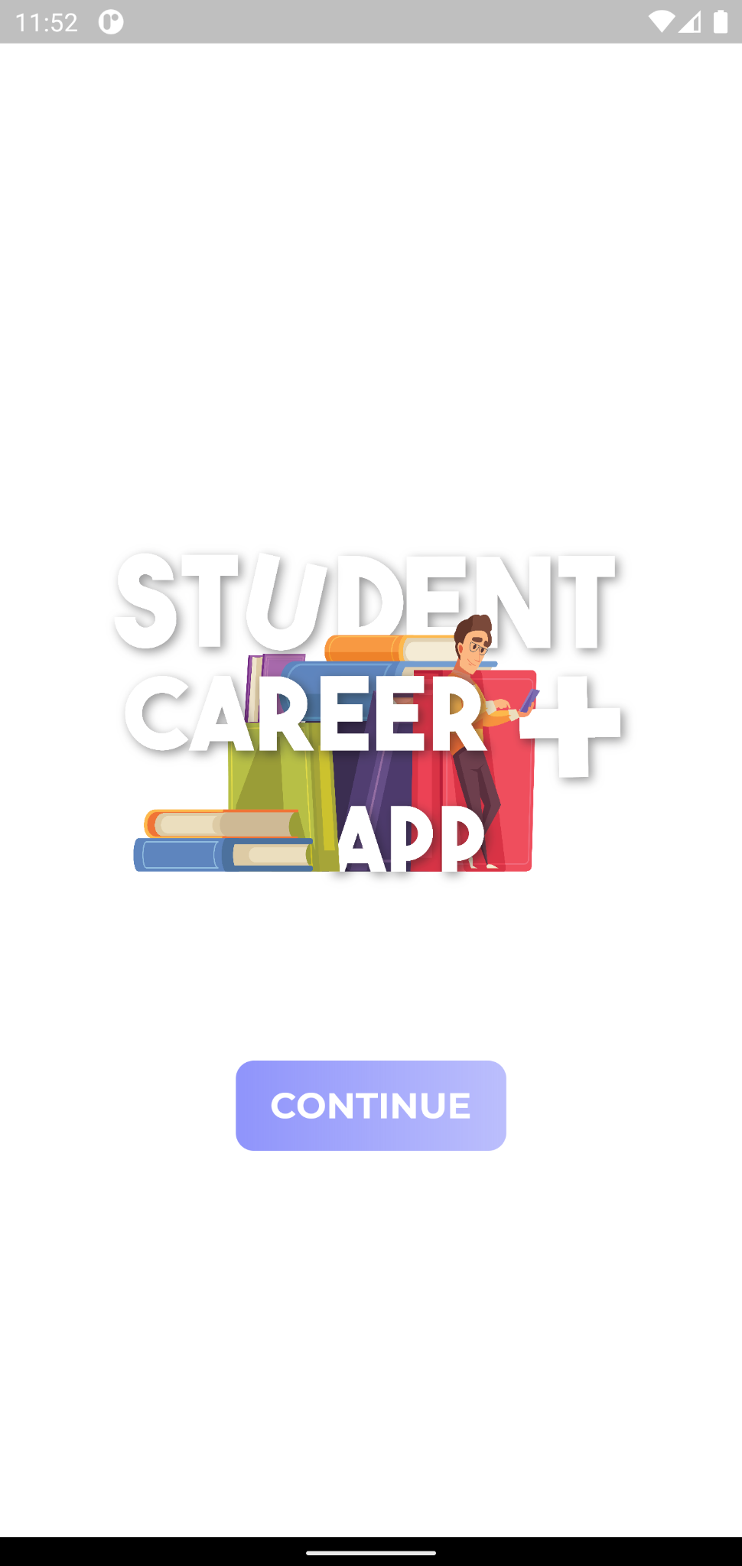
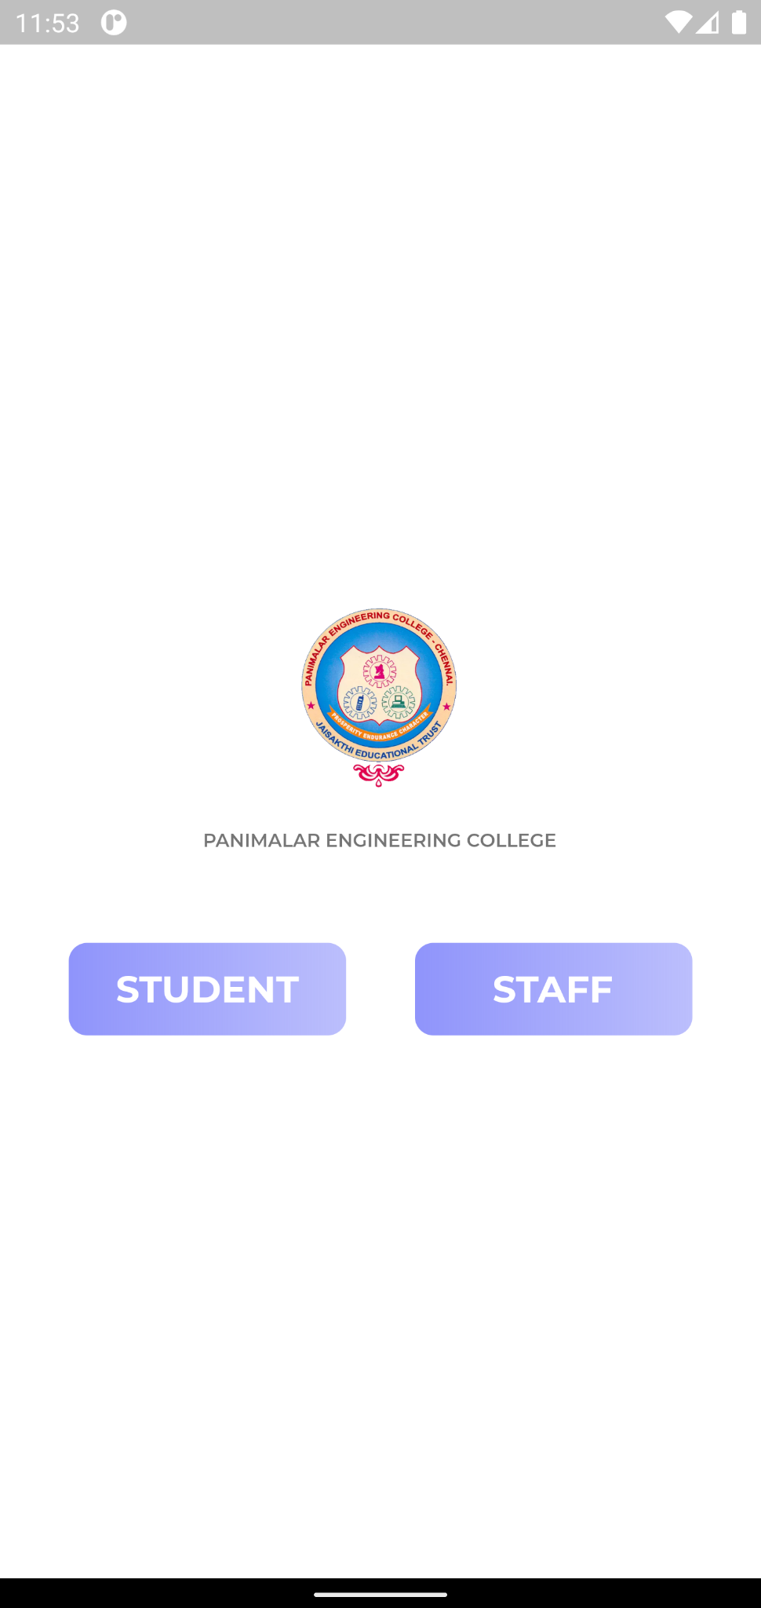
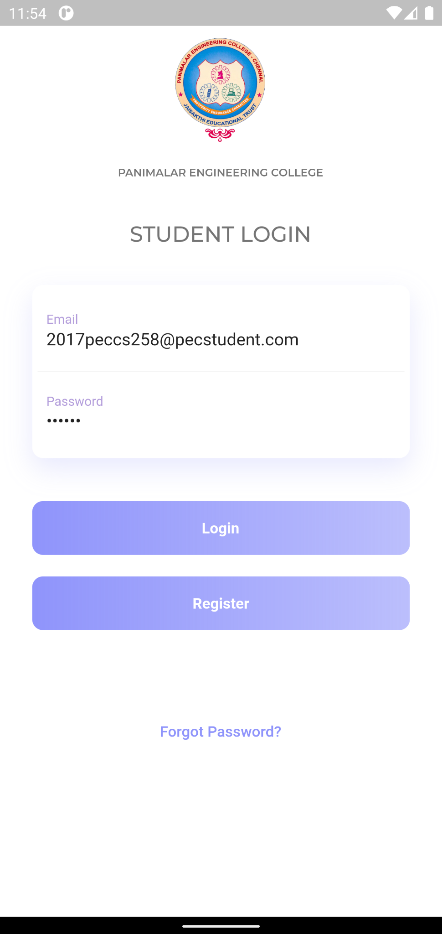
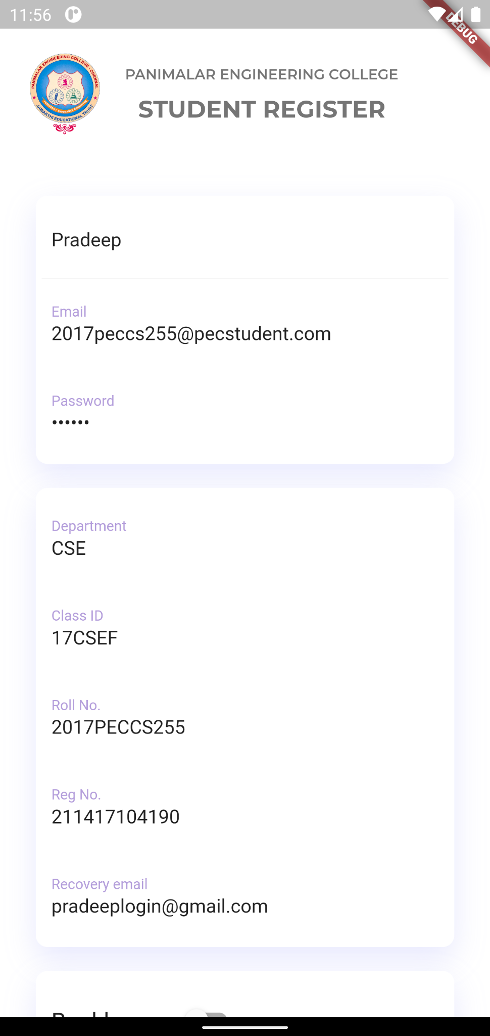
SCREENSHOTS LOGIN AND REGISTER

Slide 23
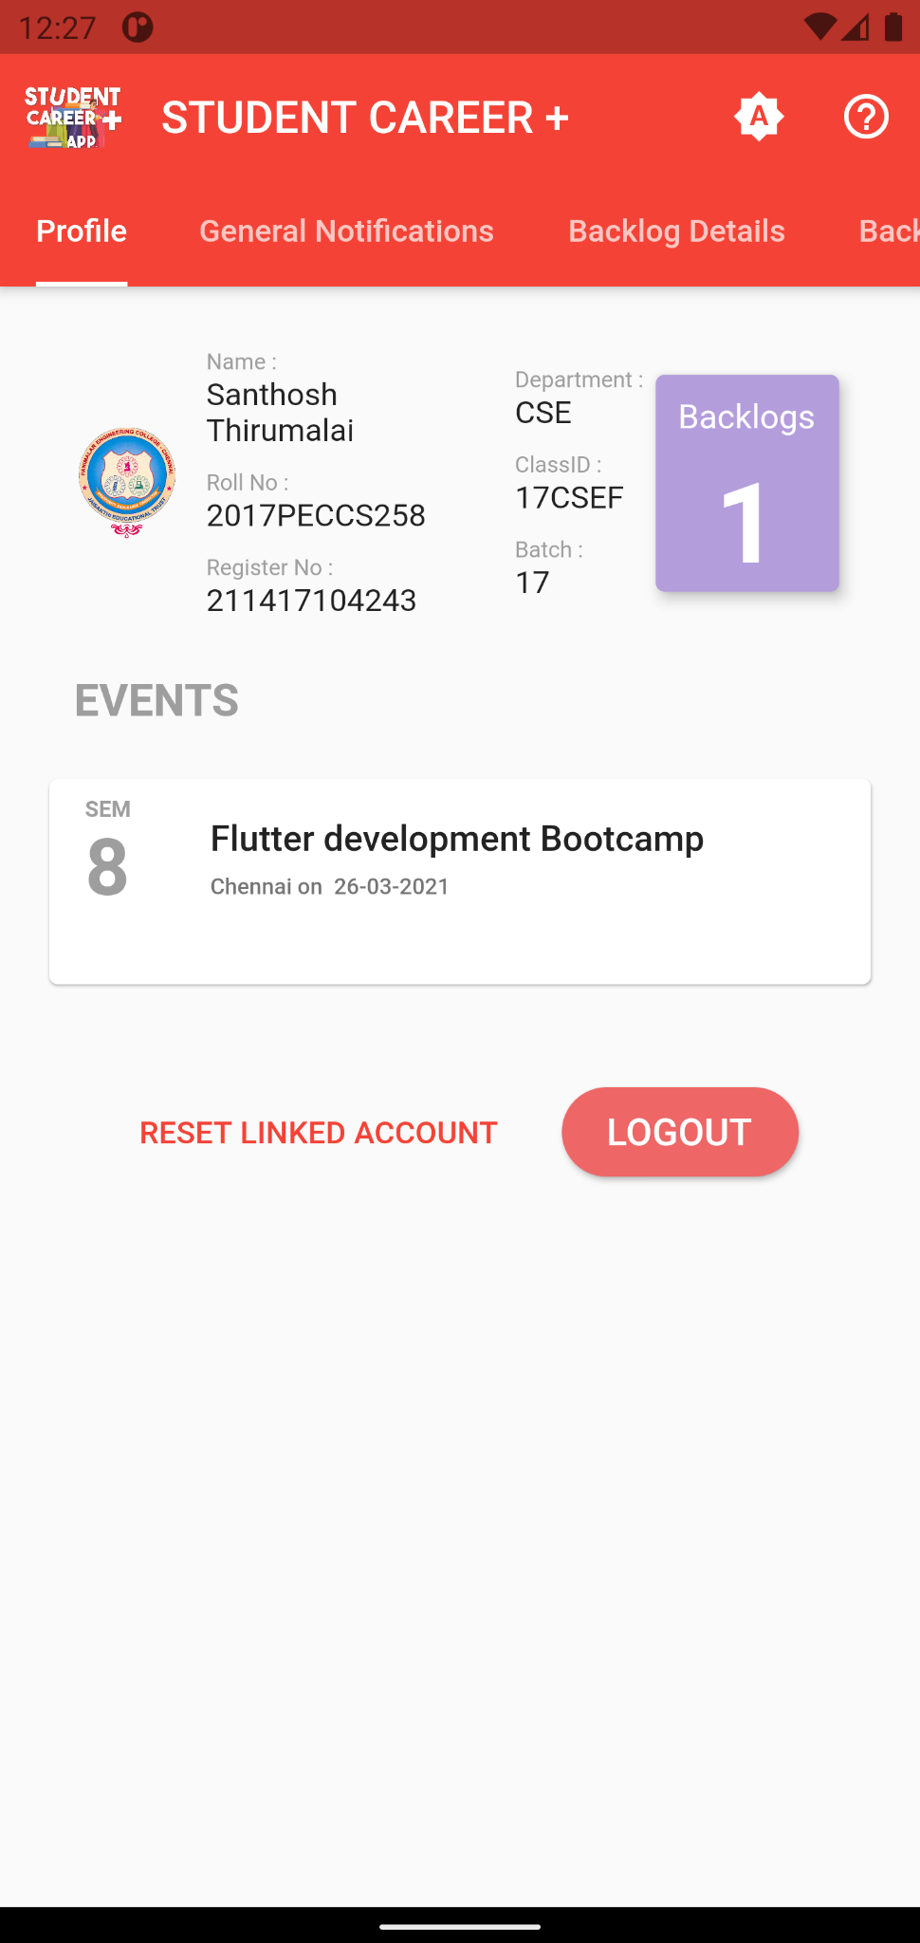
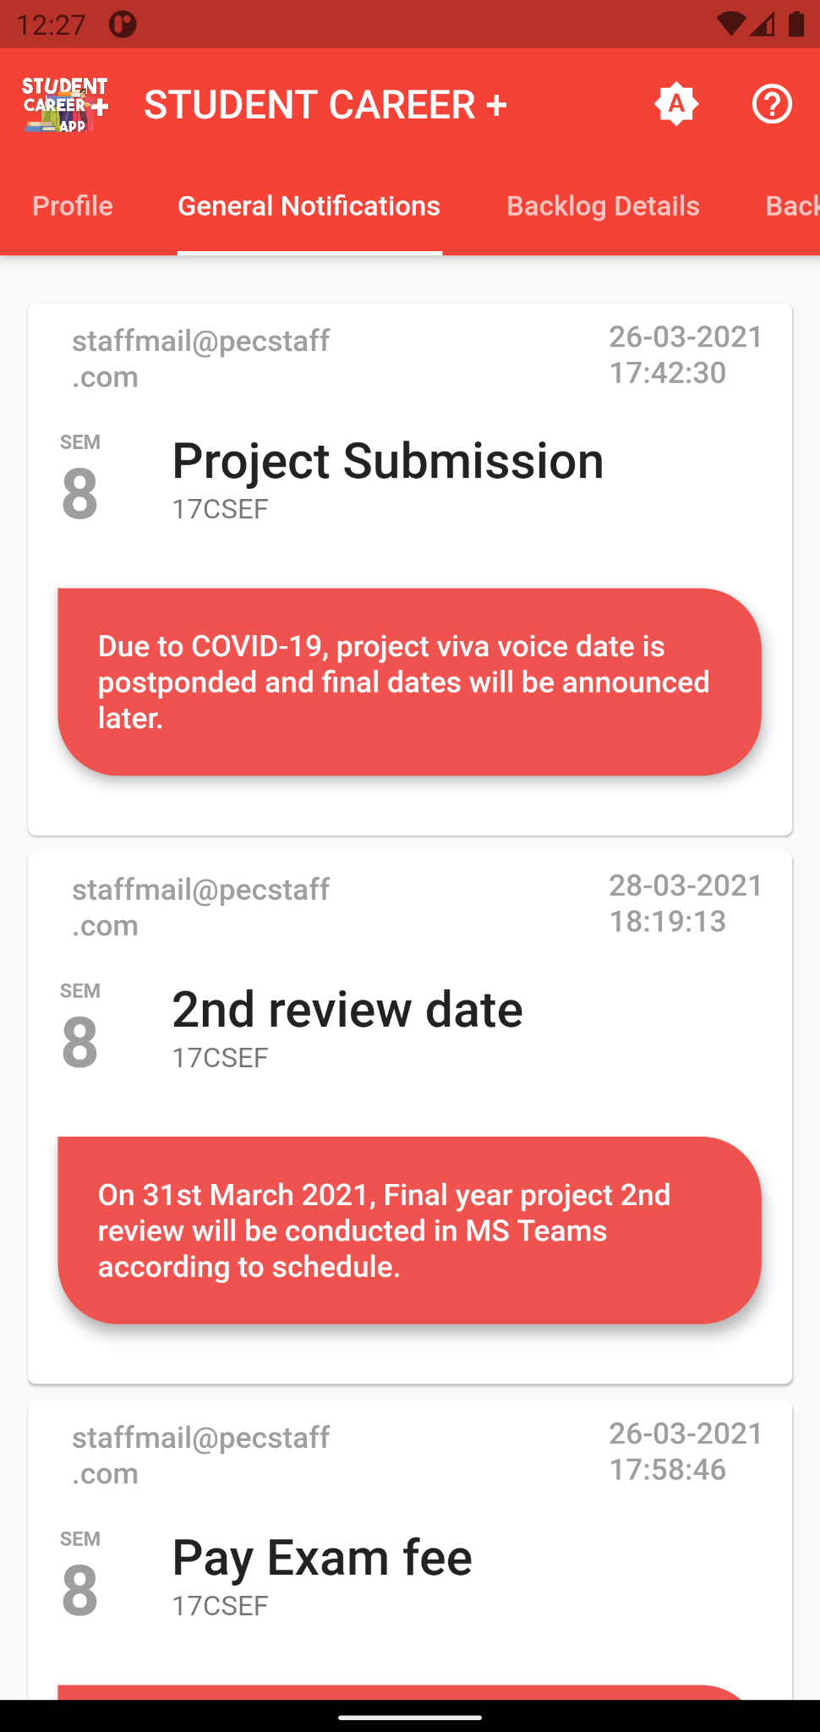
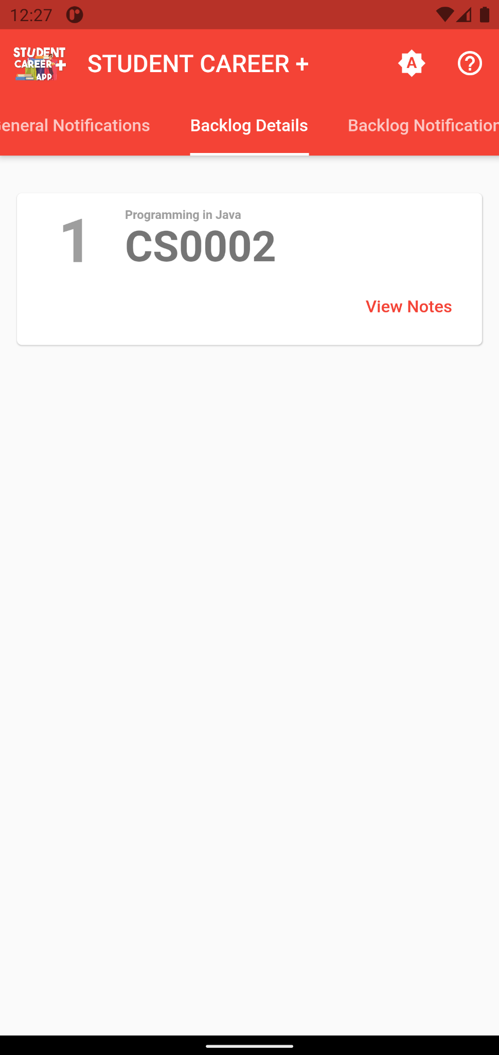
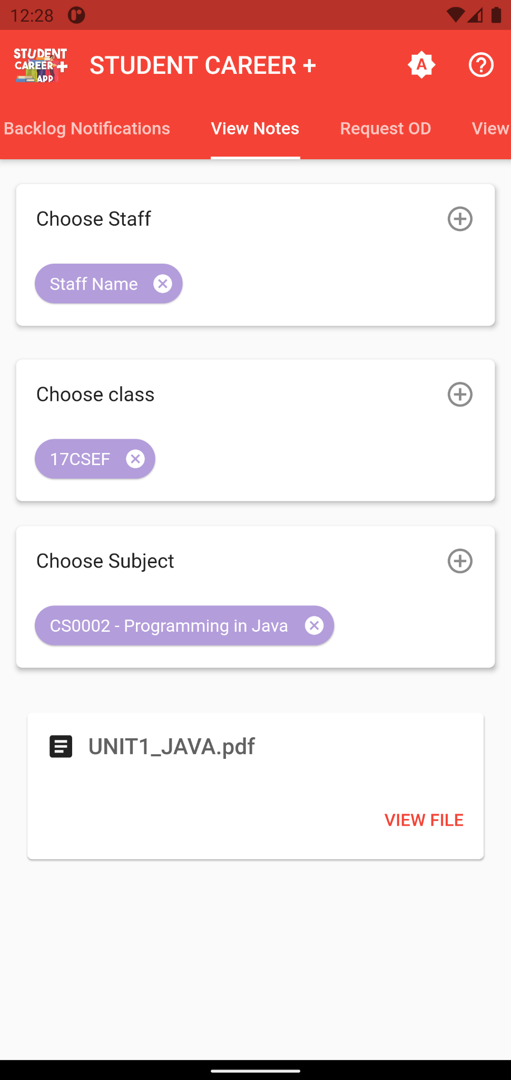
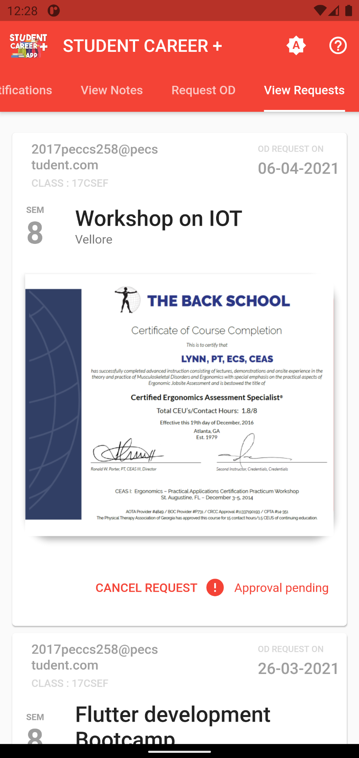
SCREENSHOTS - STUDENT TABS

Slide 24
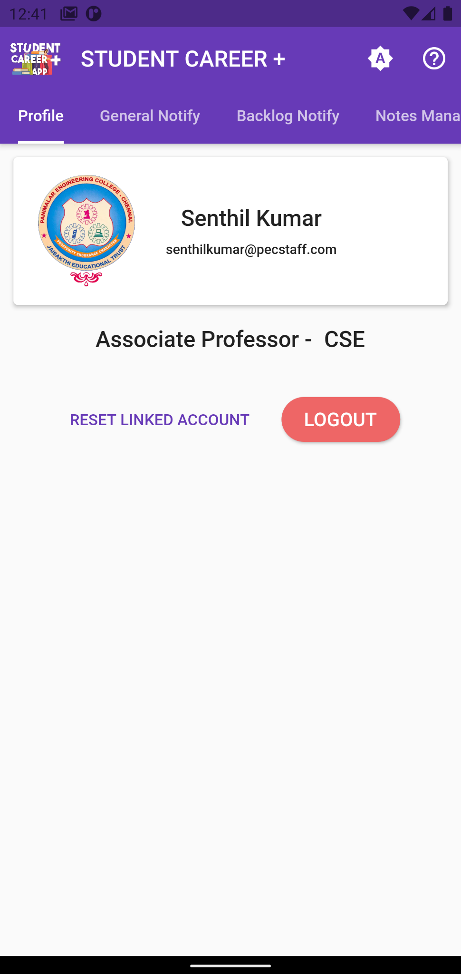
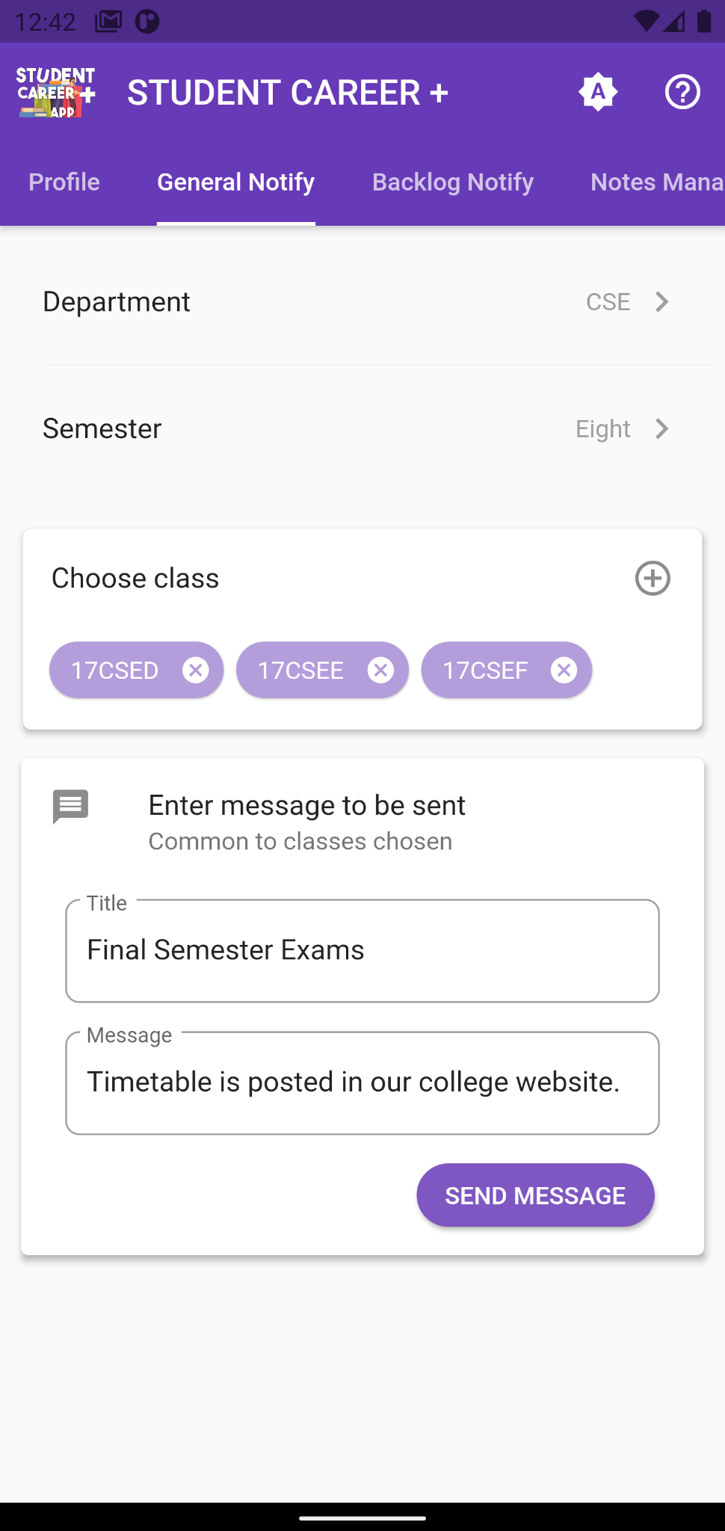
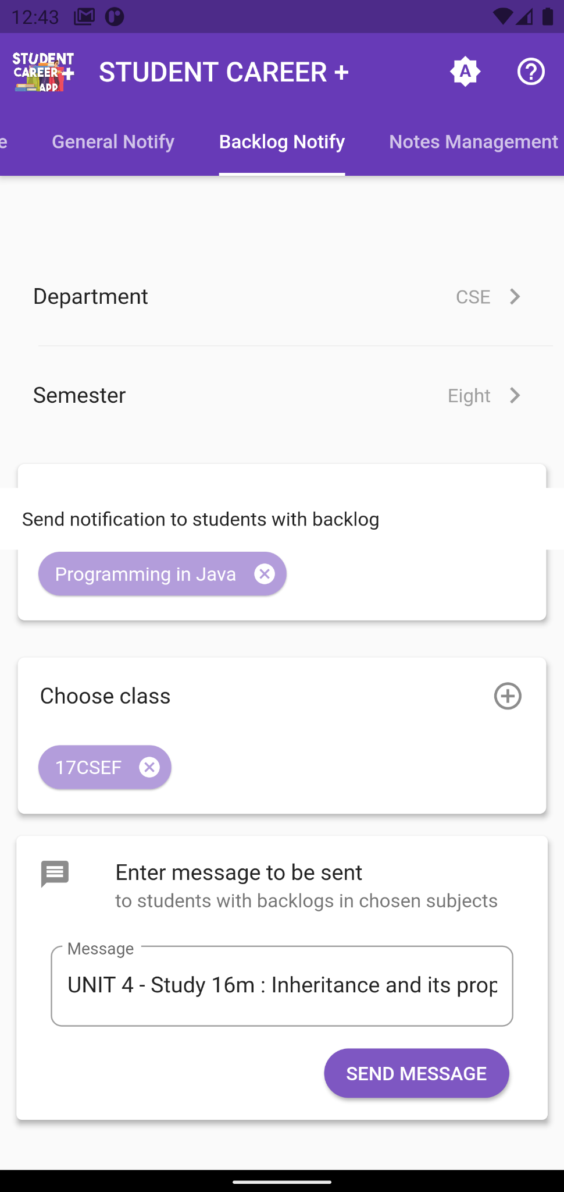
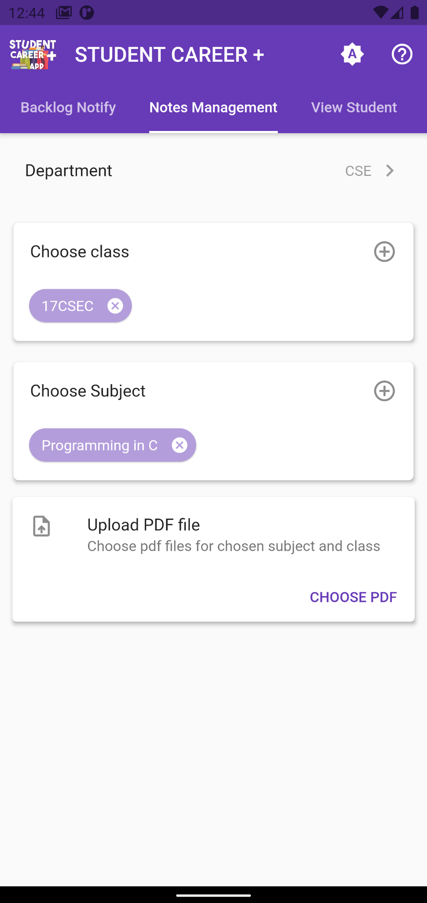
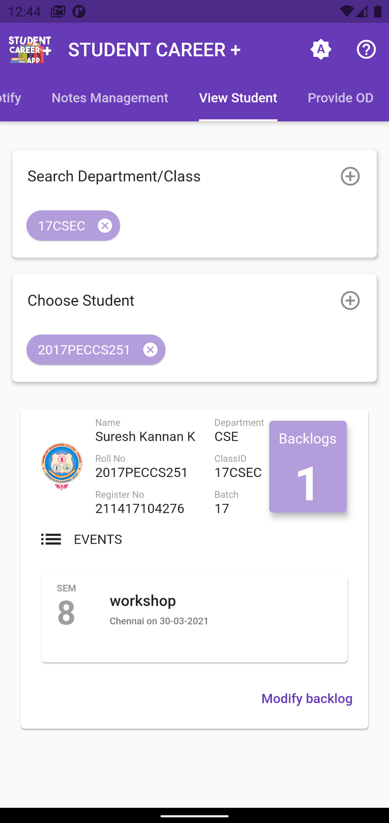
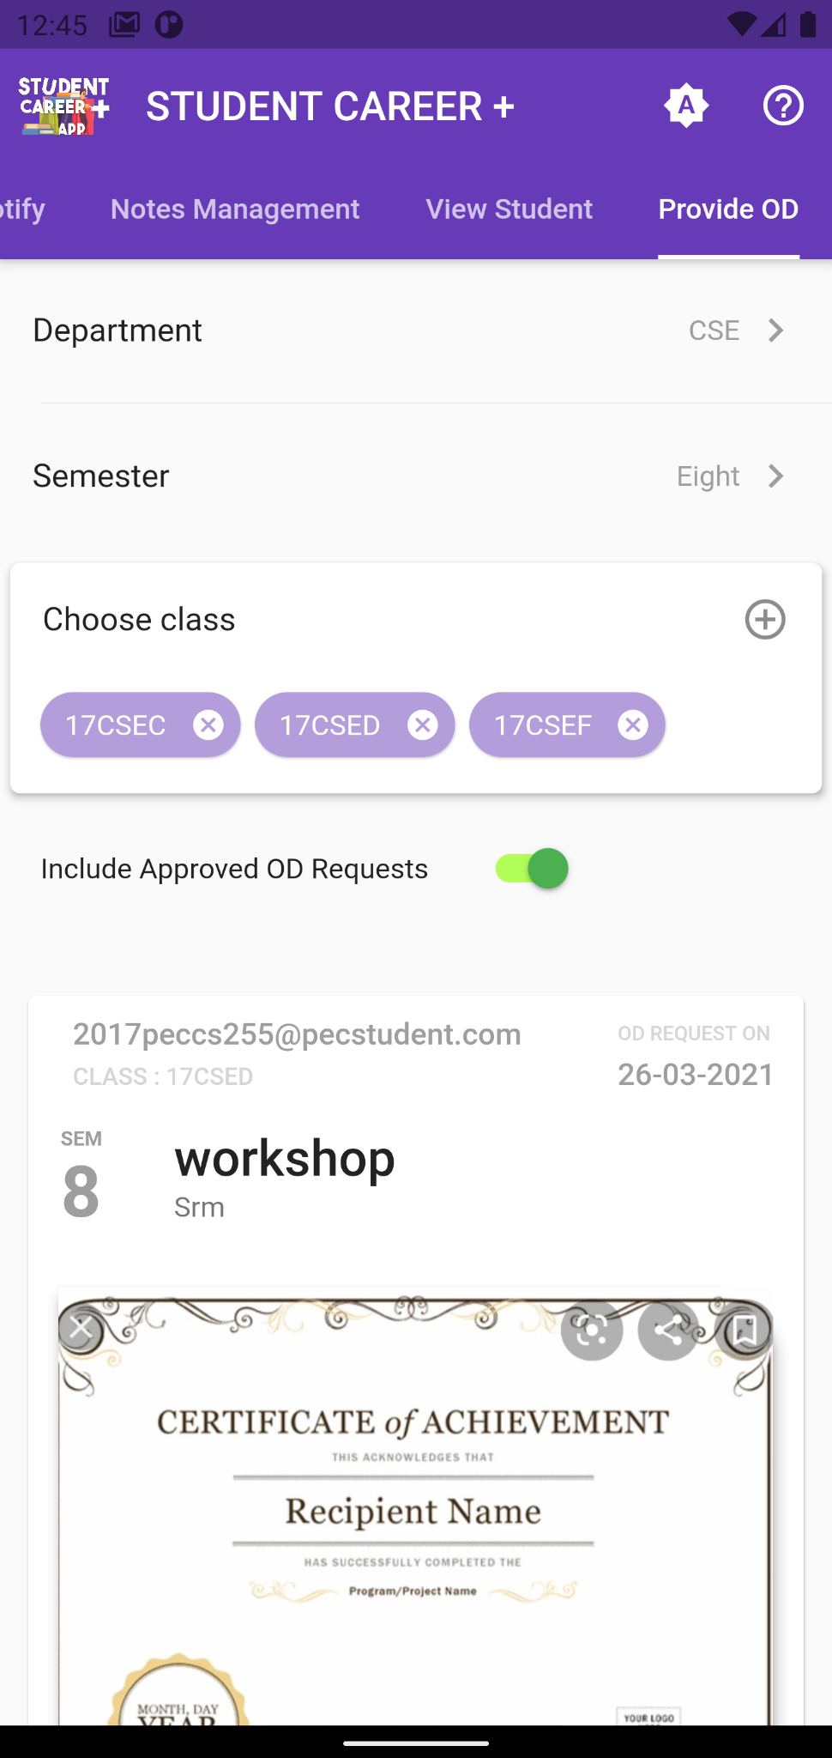
SCREENSHOTS - STAFF TABS

Slide 25
Conclusion
This project focuses mainly on enhancing communication between the staff and students with the use of trending technologies. A simple notification that can be received anywhere anytime could possibly make an impact over a student’s career.

Slide 26
REFERENCES
Package references:
Google Sign In: https://pub.dev/packages/google_sign_in
Cupertino Icons: https://pub.dev/packages/cupertino_icons
Theme Patrol: https://pub.dev/packages/theme_patrol
Sticky Headers: https://pub.dev/packages/sticky_headers
Smart Select: https://pub.dev/packages/smart_select
Simple Animations: https://pub.dev/packages/simple_animations
Firebase Core: https://pub.dev/packages/firebase_core
Firebase Authentication: https://pub.dev/packages/firebase_auth
Firebase Storage: https://pub.dev/packages/firebase_storage
Firebase Messaging: https://pub.dev/packages/firebase_messaging
Cloud Firestore: https://pub.dev/packages/cloud_firestore
Modal Progress HUD: https://pub.dev/packages/modal_progress_hud
Image Picker: https://pub.dev/packages/image_picker
Permission Handler: https://pub.dev/packages/permission_handler
Shared Preferences: https://pub.dev/packages/shared_preferences
Flutter Toast: https://pub.dev/packages/fluttertoast
File Picker: https://pub.dev/packages/file_picker
PDF Viewer: https://pub.dev/packages/flutter_plugin_pdf_viewer
Carousel Slider: https://pub.dev/packages/carousel_slider
Design Reference:
Material Design Icons: https://www.materialpalette.com/icons
Main Course : https://www.udemy.com/course/flutter-bootcamp-with-dart/
GitHub Repository: https://github.com/londonappbrewery/Flutter-Course-Resources
Reference for basics :
Flutter documentation: https://flutter.dev/docs
Firebase documentation: https://firebase.google.com/docs/build
Firestore documentation: https://firebase.flutter.dev/docs/firestore/usage/
Cloud function documentation: https://fireship.io/lessons/flutter-push-notifications-fcm-guide/

Slide 27
Thank You

